Slide 1
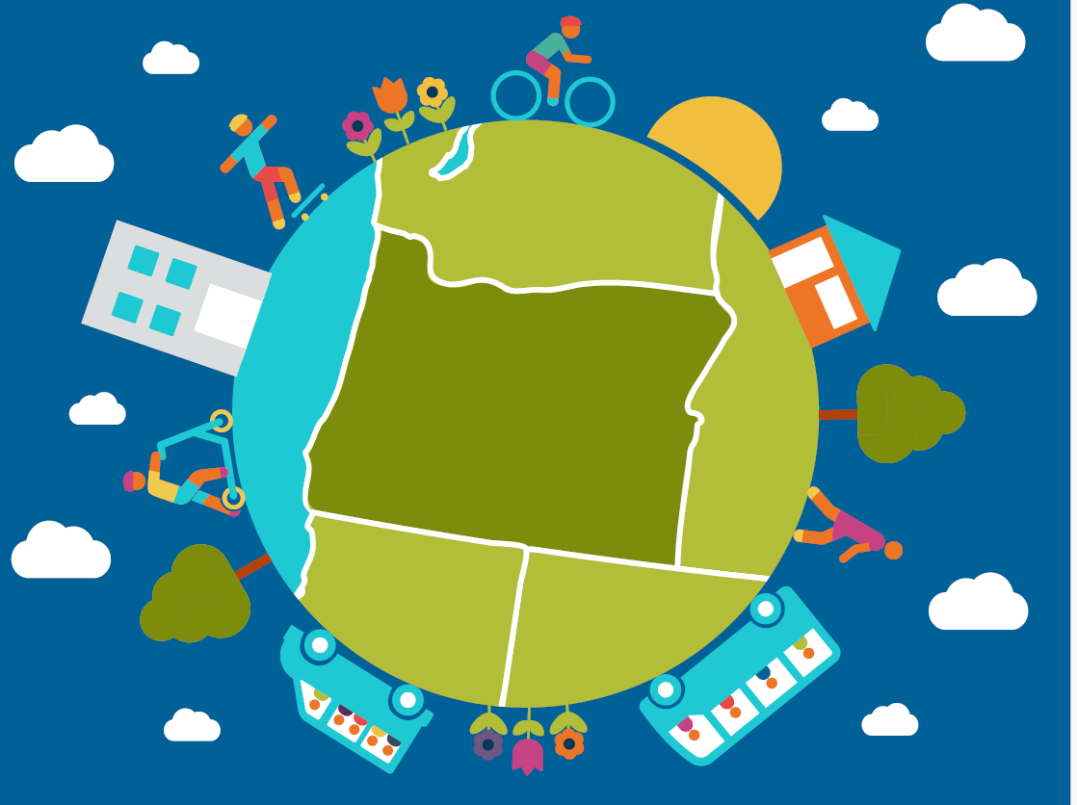

Ready to win prizes for driving less?
Join Oregon’s
Get There Car Free Challenge!
Sept. 16-22

Slide 2



Pledge to drive less
Log your transit, walk, bike, scooter, carpool, & vanpool trips
Win prizes!
Join the movement at
GetThereOregon.org/
Challenge

