Slide 1
Celebrate The 10th Annual Get There Challenge!
Oct. 3-16, 2022
Join Anytime— GetThereOregon.org/Challenge

Slide 2
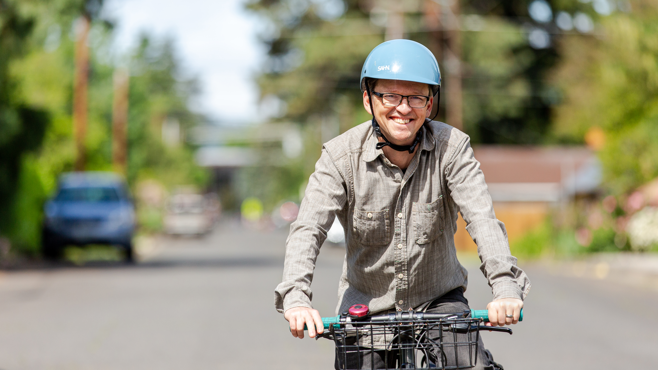
Unlock fun, experiences, knowledge, and skill-building achievements for your chance to earn points towards prizes and make your commute better!
Get Active
Drive Less
Save Money
Win Prizes

Slide 3
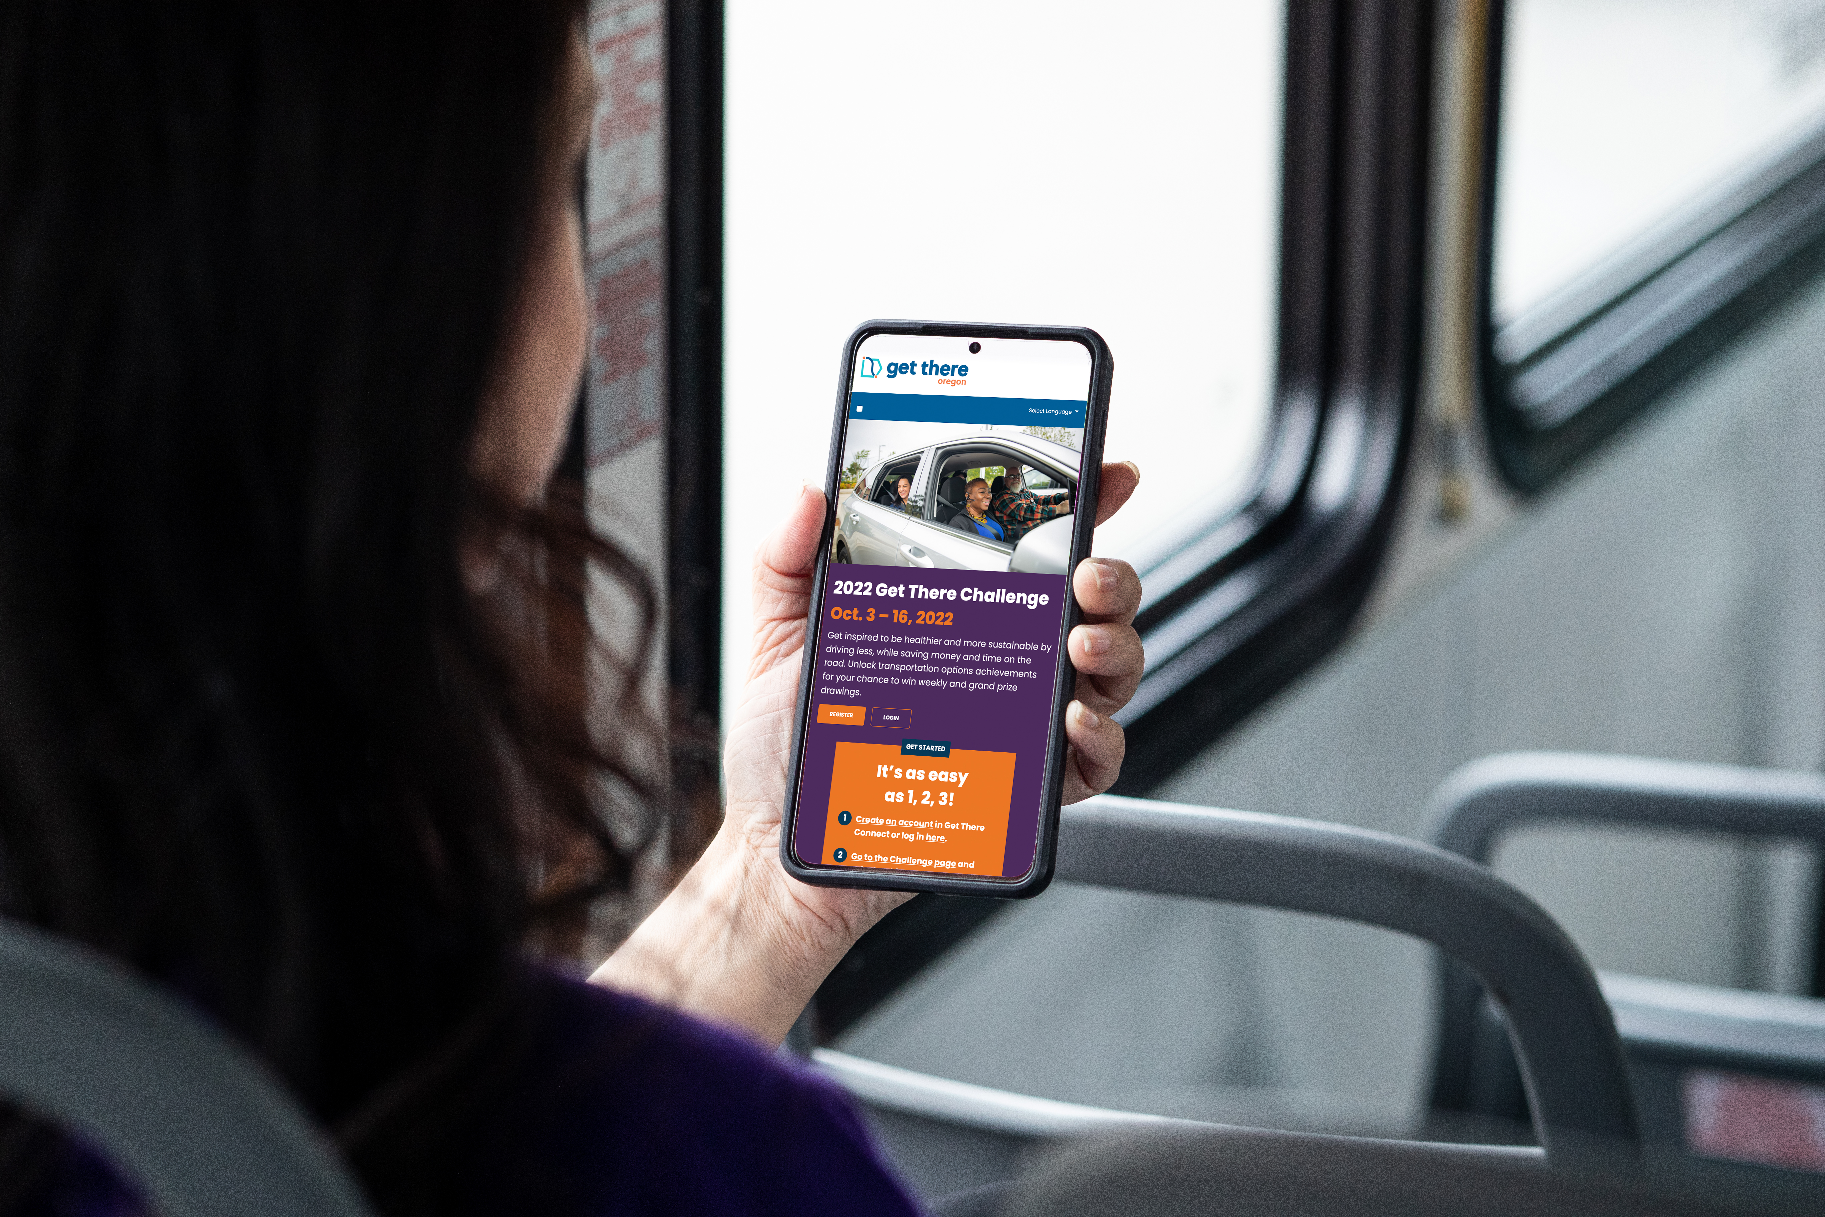
Join Anytime
Oct. 3-16, 2022
Create an account or log in at GetThereOregon.org/Challenge
Unlock achievements to earn points
Get entered to win prizes!

